Slide 1
New Year, New You Review and Closing
Presented by: Bailey Martin

Slide 2
Topics Discussed
Health Screening and Numbers
Cholesterol (HDL and LDL), Triglycerides, Blood Sugar, A1C
Physical Therapy Staff presents exercising ideas
Macronutrients
Protein, Carbohydrates, Fats
Mindful Eating with Jay David
Inflammation and Sugar Addiction
Guest Speaker Kim Knudsen shared about her health journey

Slide 3
Any questions about those topics?

Slide 4
Todays Agenda:
Metabolism
Smart swaps when cooking
3. Discussion for success through this program and areas of improvement

Slide 5
Metabolism – what is it?
According to MayoClinic:
“The process by which your body converts what you eat or drink into energy”

Slide 6
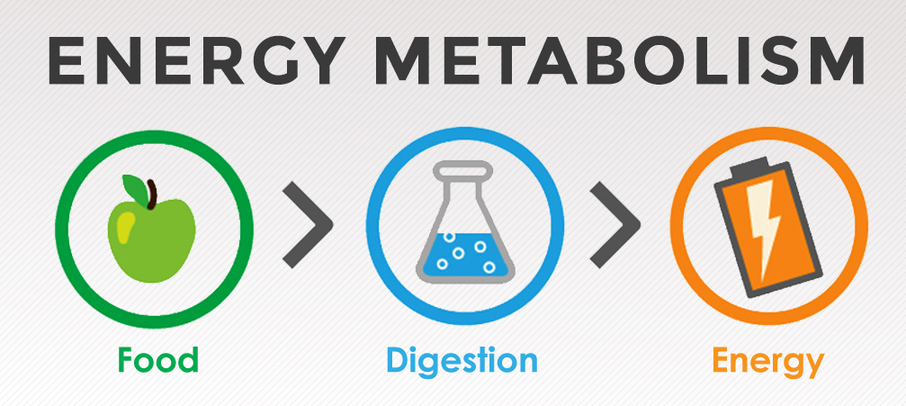
4 Factors that affect metabolism
Basal metabolic Rate
Age, Sex, Height Genetic Makeup
Improve the muscle to fat ratio on your body
The hormone insulin
We want your body to be insulin sensitive
Getting healthy bacteria in the digestion system
Natural thermogenesis of certain foods
Higher protein foods

Slide 7
Smart swaps
Spaghetti squash for pasta
1. Chop the squash in half
2. With a spoon, scrape the seeds and middle out
3. In a glass pan, put 1" of water and place the squash cut- side down
4. Bake on 400 Fahrenheit for 35-50 minutes
Cauliflower rice
1. chop up in food processor or by hand
2. Throw it in a pan and cook it with spices
Quinoa instead of white rice
Twice the amount of protein
Baked sweet potatoes instead of chips
Cauliflower pizza crust
1 head of cauliflower, 1 egg, 1/2 cup of cheese, Spices of choice
Steam cauliflower for 5 minutes
Chop cauliflower finely in a food processor
Squeeze out excess water with cheesecloth or towel
Combine with the other ingredients
Par-bake at 350 F for 10 minutes
Place toppings on and bake at 350 F for 15-20 minutes
Plain, Greek Yogurt
Instead of mayonnaise in chicken salad
Instead of sour cream in recipes and as a topping
If you are craving a dessert or jam, opt for a baked apple or banana instead

Slide 8
Your Time to Shine!
What did you feel like you took from this class?
Anything I can further help with?
Suggested improvements or topics to continue with this class

Slide 9
Thank you for being a part of the New Year, New You Program!

